Slide 1
CHAPTER 6 Predictive Control with tracking 2 understanding the feedforward term
Anthony Rossiter

Slide 2
Background
The first video reminded viewers that a default MPC approach uses future values for the target.
However, a typical MPC algorithm seems to behave worse when more accurate target information is provided.
This chapter seeks to understand how the feedforward information is included, and hence why this can lead to poor performance.

Slide 3
Poorly posed optimisations
Viewers are reminded of the discussions in chapter 3 which illustrated how a finite horizon algorithm can have poorly posed structure.
It was shown that small output horizons, sometimes small input horizons and indeed very large control weighting, all can lead to optimisations which do not lead to ‘optimal’ predicted behaviour.
A key ‘check’, was that the optimisations from one sample to the next should be consistent, otherwise one is essentially changing your mind, which suggests a previous strategy was poorly chosen.

Slide 4
Using advance knowledge
This video will demonstrate why using large amounts of advance knowledge of target changes often leads to optimisation solutions which are ‘NOT OPTIMAL’ and indeed give rather poor predicted strategies.
As with chapter 3, the key starting point is to test whether the class of predictions available to the optimisation include one which is close to the closed-loop behaviour you actually want.
If this is not the case, then the optimisation CANNOT deliver a sensible answer.

Slide 5
Example 1 – almost global optimum
Consider a system with simple 1st order dynamics, and design an optimal input trajectory to follow a step change in the target.
Select best input trajectory now.
TARGET
The best solution is likely to move only shortly before the step occurs to minimise errors both sides of the step change.

Slide 6
Example 1 – GPC solution
Consider same system with ny=20, nu=2 and design a predicted GPC input trajectory at the first sample to follow a future step change in the target.
Select best input trajectory now.
TARGET
GPC has only 2 moves available, so trades off the expected tracking errors the best it can – rather poor predictions result!

Slide 7
Example 1 – GPC solution (b)
Consider same system with ny=20, but a larger nu and design a predicted GPC input trajectory at the first sample to follow a future step change in the target.
Select best input trajectory now.
TARGET
GPC has several moves available to trade off the expected tracking errors the best it can but still rather poor predictions result!

Slide 8
video6_2_example1,2.m
MATLAB code demonstrates the failings of the predictions clearly.

Slide 9
What has gone wrong?
The degrees of freedom available to GPC are the control moves now.
In order to track a future target change, the best place for the input changes are around the time the target changes.
As this is not the case, the best solution that GPC can come up with is inappropriate at best.
ANALOGY: Design a sequence of steering wheel changes that are implemented in next 2 seconds but are designed to take you around a corner 200 yds away. Clearly fails!

Slide 10
video6_2_example1a.m
Good tracking requires the control activity to be around the set point change.
Errors balanced both sides of set point change.
This example only allows GPC to use r_{k+6} and not r_{k+20}!

Slide 11
Summary
Demonstrated that although the default definition of GPC includes information about future targets, it does not use this information wisely.
The use of a finite control horizon means that the class of available input predictions is only flexible enough to deal with set point changes within the control horizon.
Including more accurate future target information into GPC is counter productive because the required changes in the control trajectory are not available within the optimisation.

Slide 12



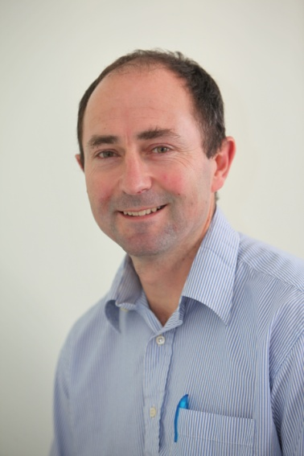
Anthony Rossiter
Department of Automatic Control and Systems Engineering
University of Sheffield
www.shef.ac.uk/acse
© 2014 University of Sheffield
This work is licensed under the Creative Commons Attribution 2.0 UK: England & Wales Licence. To view a copy of this licence, visit http://creativecommons.org/licenses/by/2.0/uk/ or send a letter to: Creative Commons, 171 Second Street, Suite 300, San Francisco, California 94105, USA.
It should be noted that some of the materials contained within this resource are subject to third party rights and any copyright notices must remain with these materials in the event of reuse or repurposing.
If there are third party images within the resource please do not remove or alter any of the copyright notices or website details shown below the image.
(Please list details of the third party rights contained within this work.
If you include your institutions logo on the cover please include reference to the fact that it is a trade mark and all copyright in that image is reserved.)

